Slide 1

Machine Learning
Session 6 - T
Unsupervised Learning – Dimensionality Reduction
Ciência de Dados Aplicada
2023/2024

Slide 2
Dimensionality Reduction
Objective: transforming high-dimensional data into a lower-dimensional representation, aiming to capture the essential patterns and relationships within the data while minimizing redundancy and noise.
Why reduce dimensions?
Simplifies analysis and visualization of complex data;
Reduces computational complexity and memory requirements;
Helps mitigate the curse of dimensionality;
Improves model performance and generalization;
Enhances interpretability and understanding of underlying data patterns;
Unsupervised Learning – Dimensionality Reduction
Session 6

Slide 3

Dimensionality Reduction
If we only have one feature, we can easily plot the data on a number line.
Even with this simple graph, we can see diferences between samples 1, 2 and 3 and 4, 5 and 6.
 | Feature 1
Sample 1 | 10
Sample 2 | 11
Sample 3 | 8
Sample 4 | 3
Sample 5 | 1
Sample 6 | 2
Feature 1
Unsupervised Learning – Dimensionality Reduction
Session 6

Slide 4
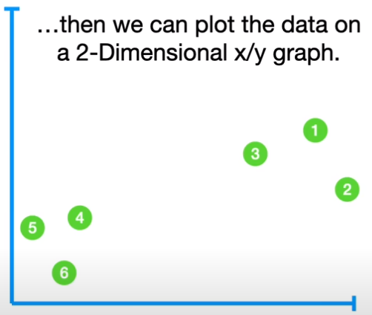
Dimensionality Reduction
Now we can plot the data on a 2-Dimensional graph.
Feature 2
 | Feature 1 | Feature 2
Sample 1 | 10 | 6
Sample 2 | 11 | 4
Sample 3 | 8 | 5
Sample 4 | 3 | 3
Sample 5 | 1 | 2.8
Sample 6 | 2 | 1
Feature 1
Unsupervised Learning – Dimensionality Reduction
Session 6

Slide 5
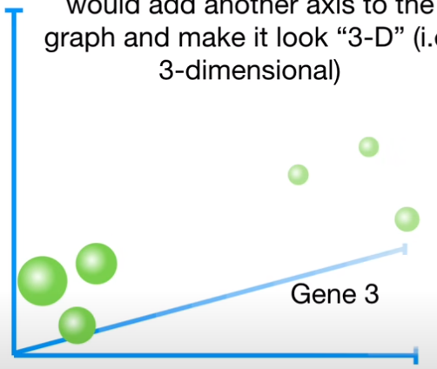
Dimensionality Reduction
Now we can plot the data on a 3-Dimensional graph.
Feature 2
 | Feature 1 | Feature 2 | Feature 3
Sample 1 | 10 | 6 | 12
Sample 2 | 11 | 4 | 9
Sample 3 | 8 | 5 | 10
Sample 4 | 3 | 3 | 2.5
Sample 5 | 1 | 2.8 | 1.3
Sample 6 | 2 | 1 | 2
Feature 3
Feature 1
Unsupervised Learning – Dimensionality Reduction
Session 6

Slide 6
Dimensionality Reduction
What about 4 or more dimensions?
 | Feature 1 | Feature 2 | Feature 3 | Feature 4 | ...
Sample 1 | 10 | 6 | 12 | 5 | ...
Sample 2 | 11 | 4 | 9 | 7 | ...
Sample 3 | 8 | 5 | 10 | 6 | ...
Sample 4 | 3 | 3 | 2.5 | 2 | ...
Sample 5 | 1 | 2.8 | 1.3 | 4 | ...
Sample 6 | 2 | 1 | 2 | 7 | ...
?
Unsupervised Learning – Dimensionality Reduction
Session 6

Slide 7
Principal Component Analysis (PCA)
It identifies the principal components, which are new variables that capture the most variance in the data;
These components are orthogonal (uncorrelated) to each other, allowing for efficient reduction of dimensions;
The first principal component explains the maximum amount of variance in the data, followed by subsequent components in descending order of variance explained.
Unsupervised Learning – Dimensionality Reduction
Session 6

Slide 8
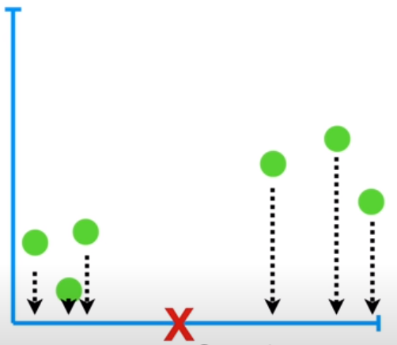
PCA Step by Step
Let's start with a simple example with 2 features.
1.) Mean center the data;
Feature 2
 | Feature 1 | Feature 2
Sample 1 | 10 | 6
Sample 2 | 11 | 4
Sample 3 | 8 | 5
Sample 4 | 3 | 3
Sample 5 | 1 | 2.8
Sample 6 | 2 | 1
Feature 1
Unsupervised Learning – Dimensionality Reduction
Session 6

Slide 9
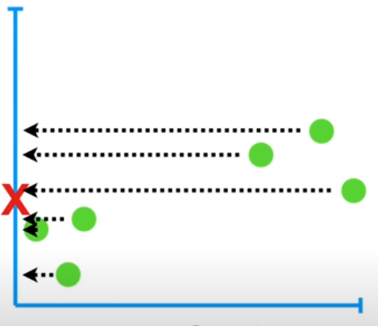
PCA Step by Step
1.) Mean center the data;
Feature 2
 | Feature 1 | Feature 2
Sample 1 | 10 | 6
Sample 2 | 11 | 4
Sample 3 | 8 | 5
Sample 4 | 3 | 3
Sample 5 | 1 | 2.8
Sample 6 | 2 | 1
Feature 1
Unsupervised Learning – Dimensionality Reduction
Session 6

Slide 10
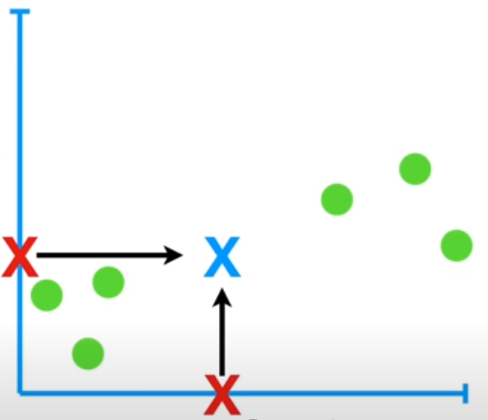
PCA Step by Step
1.) Mean center the data;
Feature 2
 | Feature 1 | Feature 2
Sample 1 | 10 | 6
Sample 2 | 11 | 4
Sample 3 | 8 | 5
Sample 4 | 3 | 3
Sample 5 | 1 | 2.8
Sample 6 | 2 | 1
Feature 1
Unsupervised Learning – Dimensionality Reduction
Session 6

Slide 11
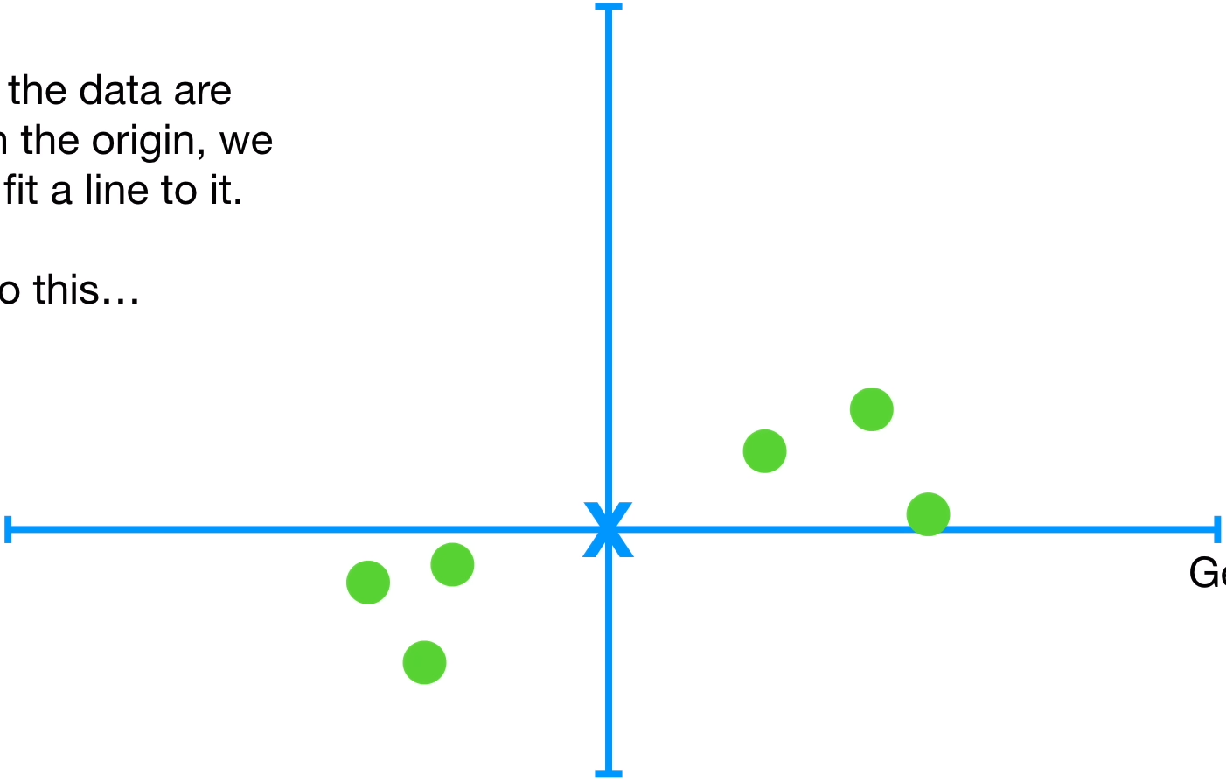
PCA Step by Step
1.) Mean center the data;
Feature 2
 | Feature 1 | Feature 2
Sample 1 | 10 | 6
Sample 2 | 11 | 4
Sample 3 | 8 | 5
Sample 4 | 3 | 3
Sample 5 | 1 | 2.8
Sample 6 | 2 | 1
Feature 1
Unsupervised Learning – Dimensionality Reduction
Session 6

Slide 12
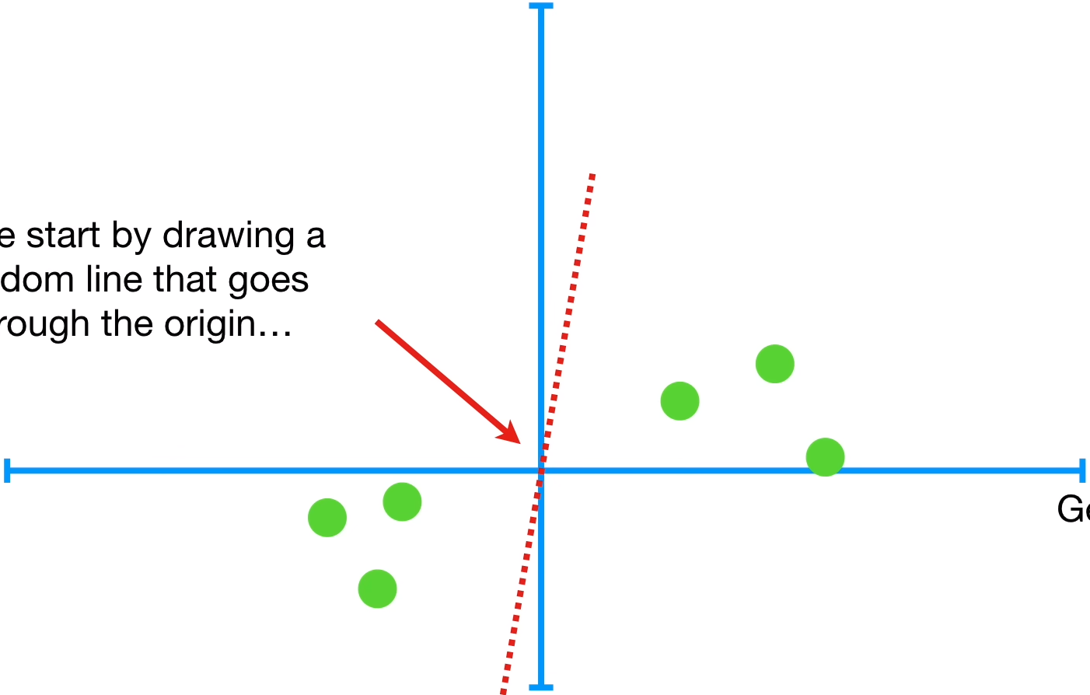
PCA Step by Step
2.) Calculate PC1 using singular value decomposition (SVD).
Feature 2
Find the line that best fits the data. But how?
Feature 1
Unsupervised Learning – Dimensionality Reduction
Session 6

Slide 13
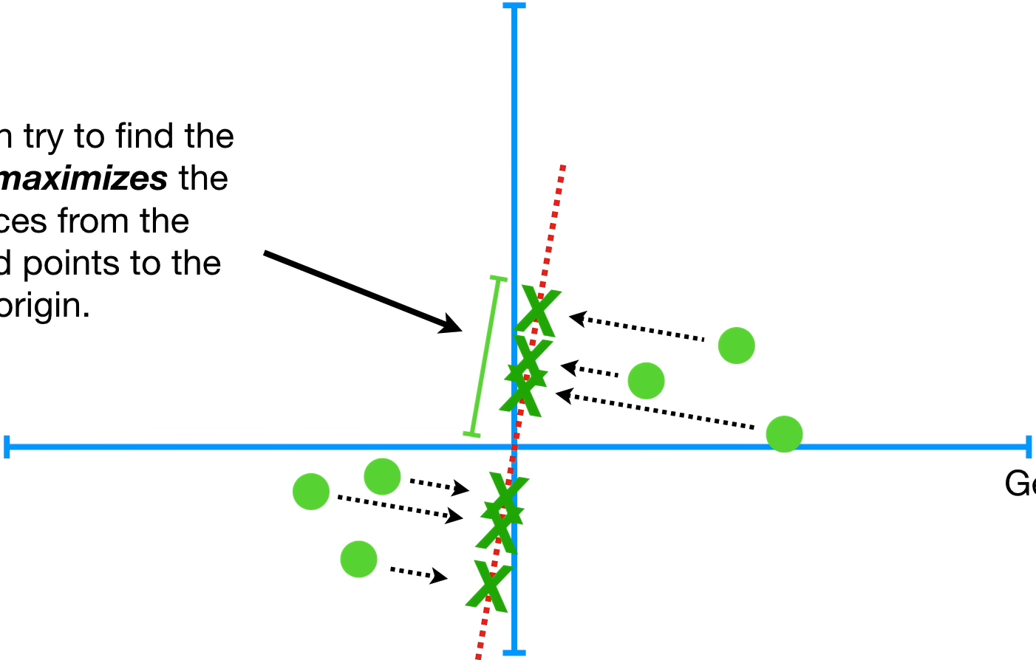
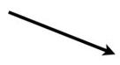
PCA Step by Step
2.) Calculate PC1 using singular value decomposition (SVD).
Feature 2
Or line that minimizes the distances of the points to the line.
Line that maximizes the distances from the projected points to the origin.
Feature 1
Unsupervised Learning – Dimensionality Reduction
Session 6

Slide 14
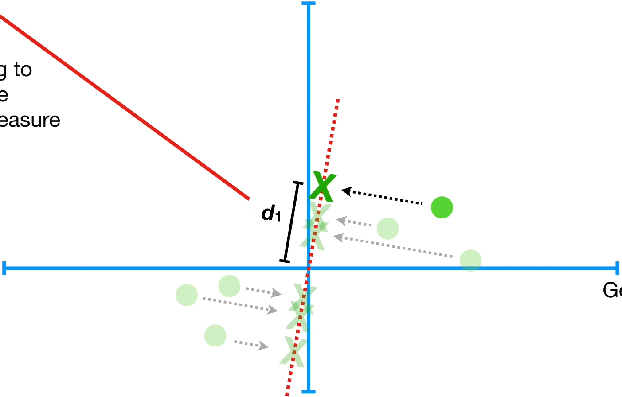
PCA Step by Step
2.) Calculate PC1 using singular value decomposition (SVD).
Feature 2
Feature 1
d1² + d2² + d3² + d4² + d5² + d6² = sum of squared distances
Unsupervised Learning – Dimensionality Reduction
Session 6

Slide 15
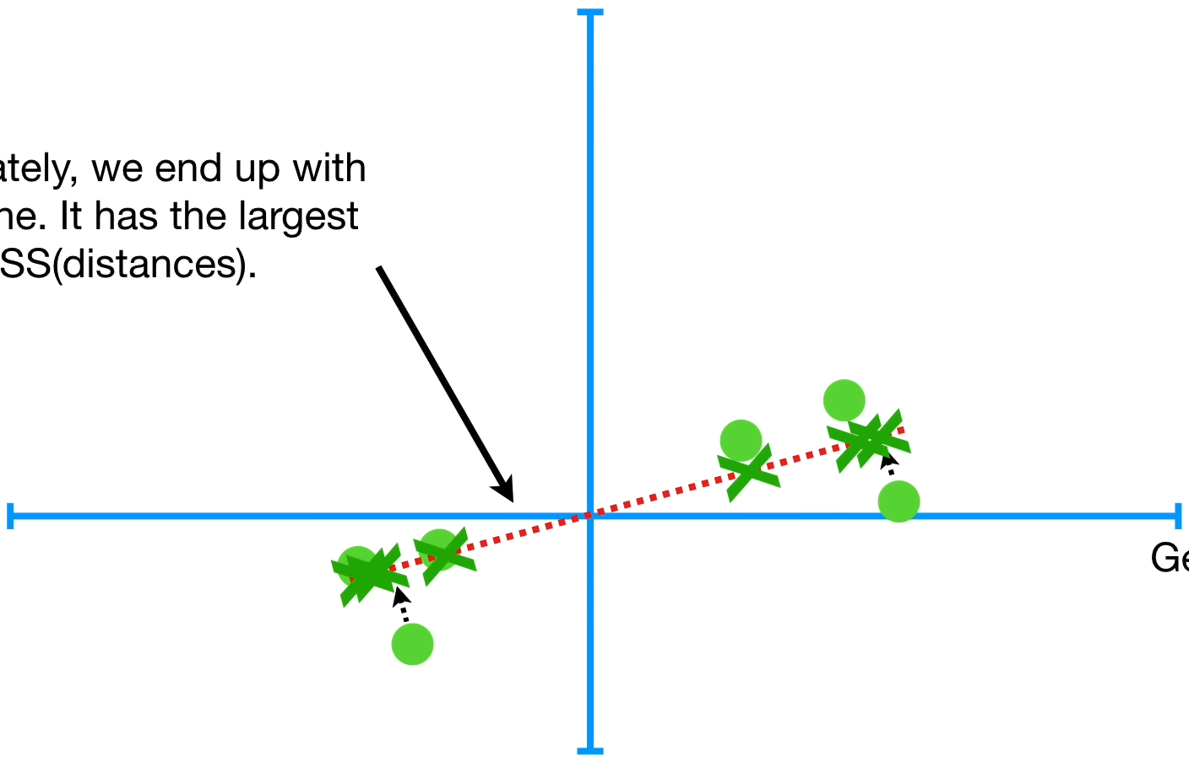
PCA Step by Step
2.) Calculate PC1 using singular value decomposition (SVD).
Feature 2
We end up with this line.
It has the largest sum of squared distances.
This line is called Principal Component 1 (PC1).
Feature 1
The average of the sum of squared distances for PC1 is named Eigenvalue for PC1.
d1² + d2² + d3² + d4² + d5² + d6² = sum of squared distances
Unsupervised Learning – Dimensionality Reduction
Session 6

Slide 16
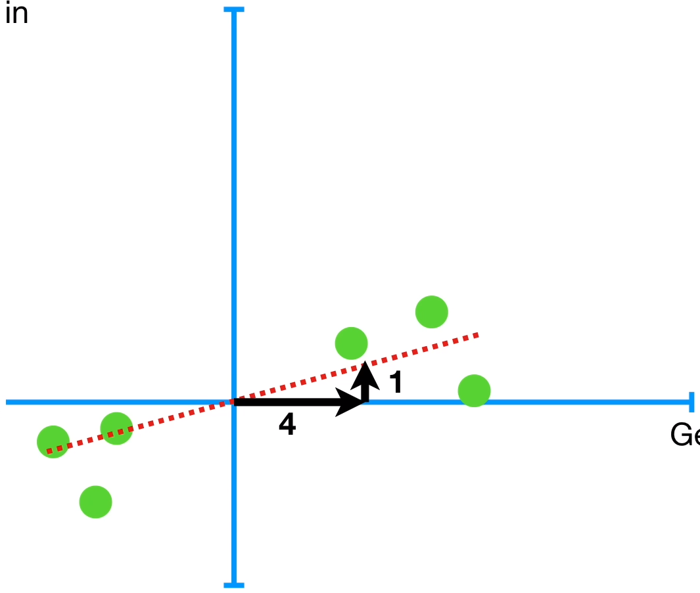
PCA Step by Step
2.) Calculate PC1 using singular value decomposition (SVD).
Feature 2
Let's say that the slope of the line is 0.25.
For 4 units of Feature 1 we increase 1 unit in feature 2.
PC1 is a linear combination of Feature 1 and 2.
Feature 1
Unsupervised Learning – Dimensionality Reduction
Session 6

Slide 17
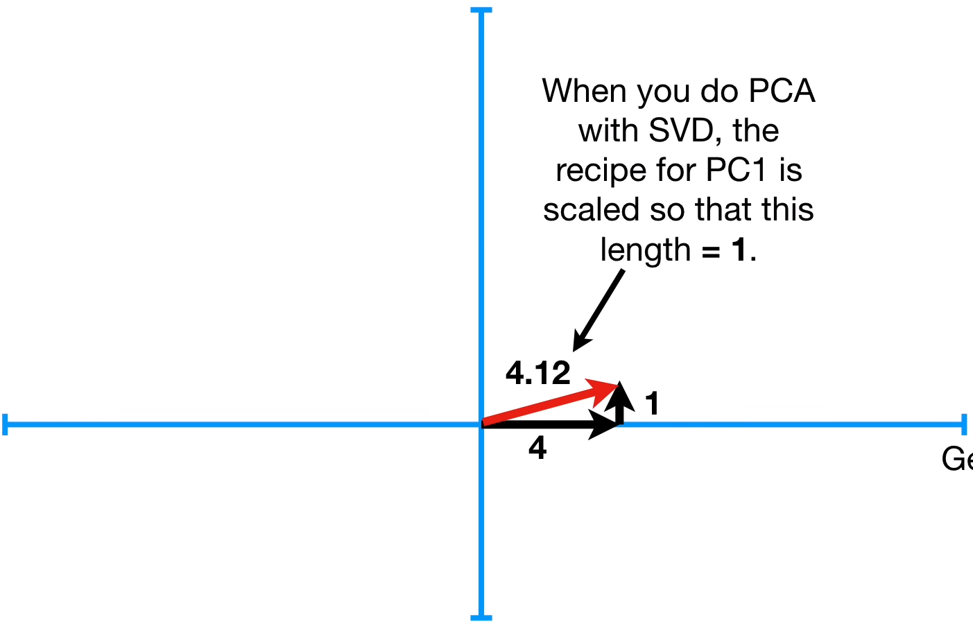
PCA Step by Step
2.) Calculate PC1 using singular value decomposition (SVD).
Feature 2
In PCA with SVD we scale this vector to be 1 unit long.
This vector is called Eigenvector for PC1.
Feature 1
Unsupervised Learning – Dimensionality Reduction
Session 6

Slide 18
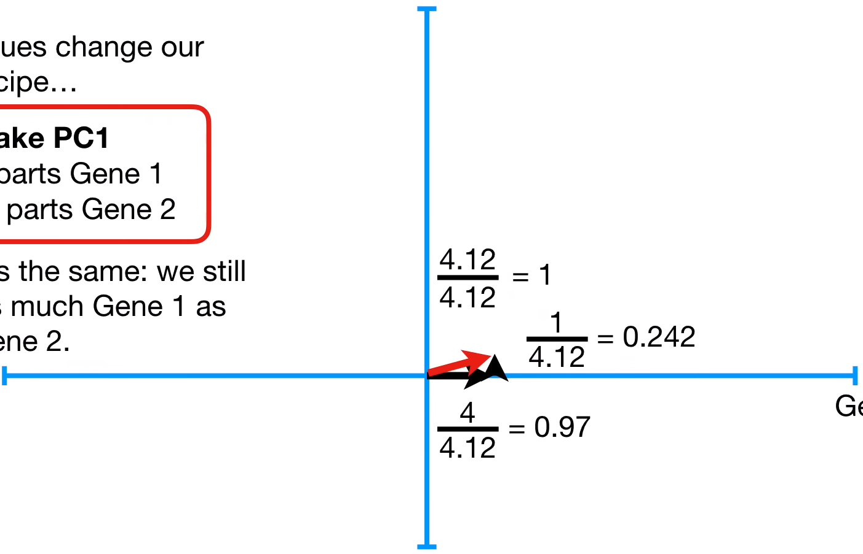
PCA Step by Step
2.) Calculate PC1 using singular value decomposition (SVD).
Feature 2
The proportions of each feature are called Loading Scores.
In this case, the Loading Scores of the Eigenvector of PC1 are 0.97 and 0.242.
Feature 1
Unsupervised Learning – Dimensionality Reduction
Session 6

Slide 19
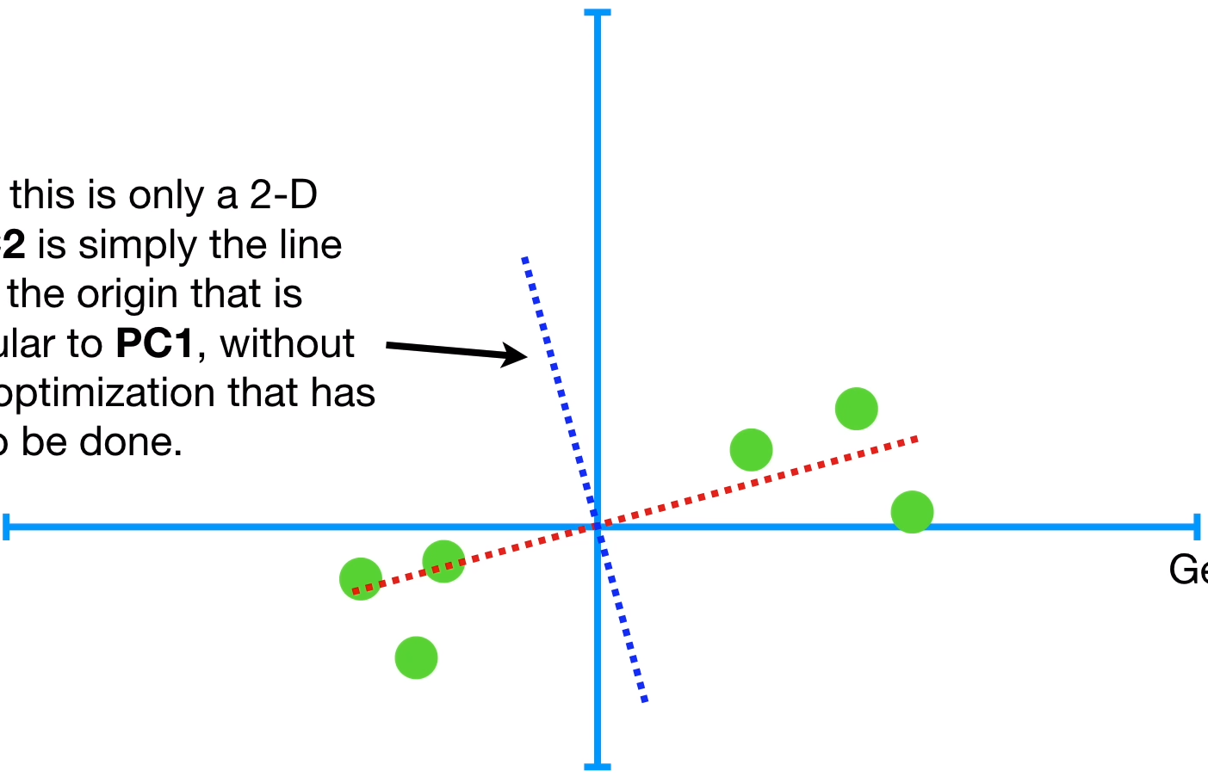
PCA Step by Step
3.) Calculate PC2 using singular value decomposition (SVD).
Feature 2
Because we only have 2 features, PC2 is simply the line through the origin that is perpendicular to PC1.
Feature 1
Unsupervised Learning – Dimensionality Reduction
Session 6

Slide 20
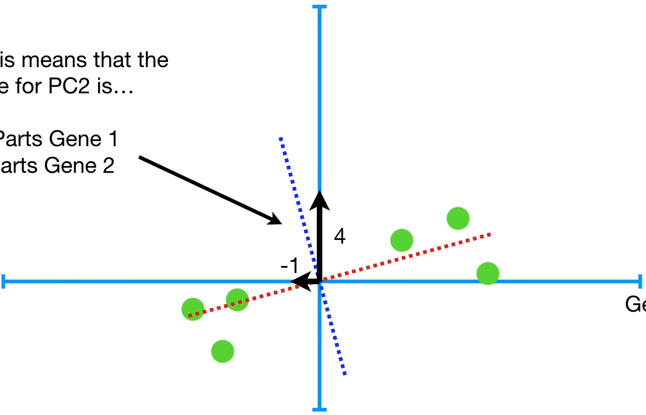
PCA Step by Step
3.) Calculate PC2 using singular value decomposition (SVD).
Feature 2
The Loading Scores of the Eigenvector of PC2 are –0.242 and 0.97.
Feature 1
Unsupervised Learning – Dimensionality Reduction
Session 6

Slide 21
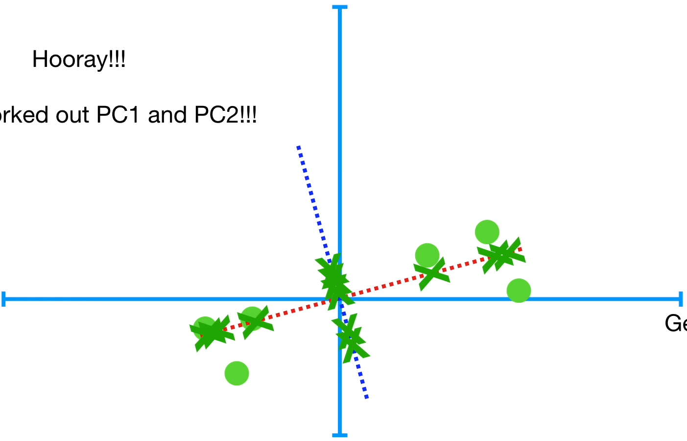
PCA Step by Step
4.) Get the final coordinates along the PCs.
Feature 2
Feature 1
Unsupervised Learning – Dimensionality Reduction
Session 6

Slide 22
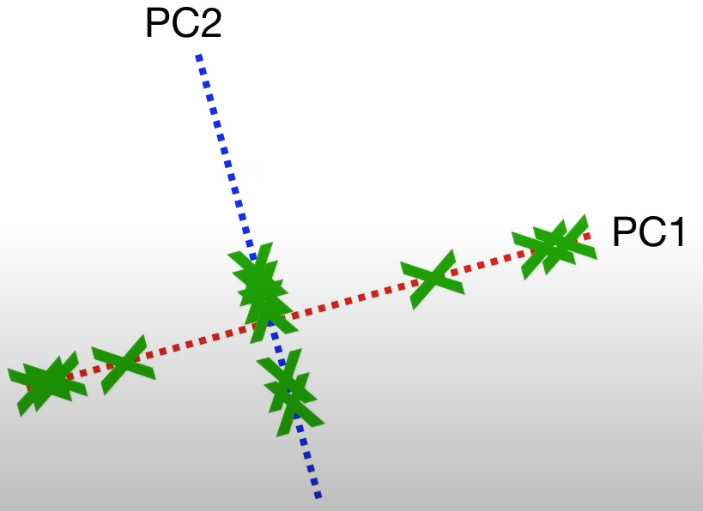
PCA Step by Step
4.) Get the final coordinates along the PCs.
Unsupervised Learning – Dimensionality Reduction
Session 6

Slide 23
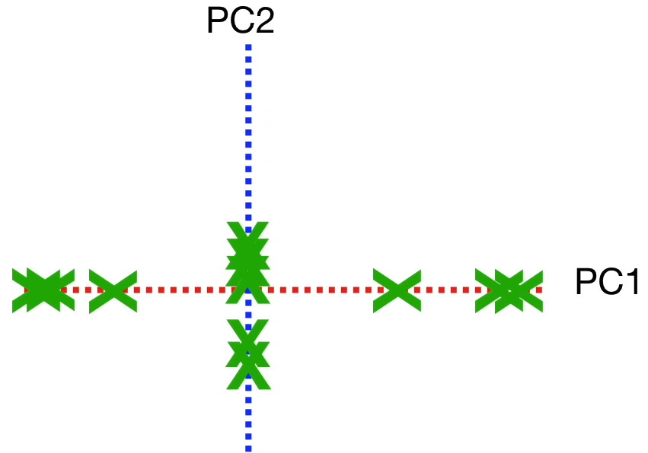
PCA Step by Step
4.) Get the final coordinates along the PCs.
Rotate the graph so PC1 is horizontal.
Unsupervised Learning – Dimensionality Reduction
Session 6

Slide 24
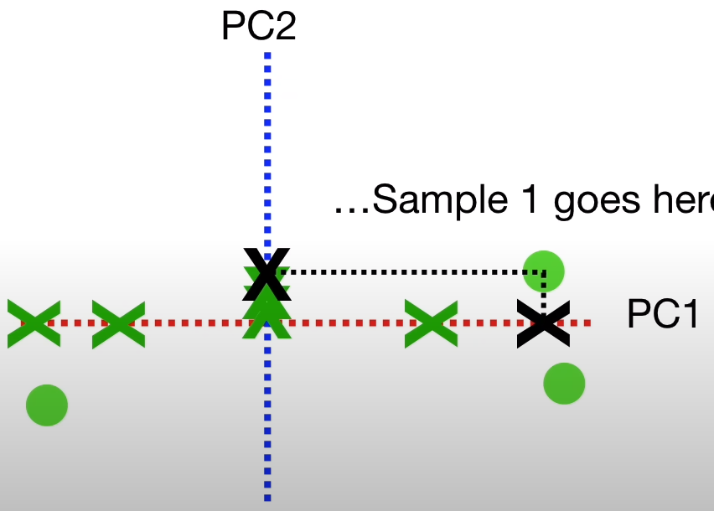
PCA Step by Step
4.) Get the final coordinates along the PCs.
We can now map the projected points bach to the samples.
Sample 1
Unsupervised Learning – Dimensionality Reduction
Session 6

Slide 25
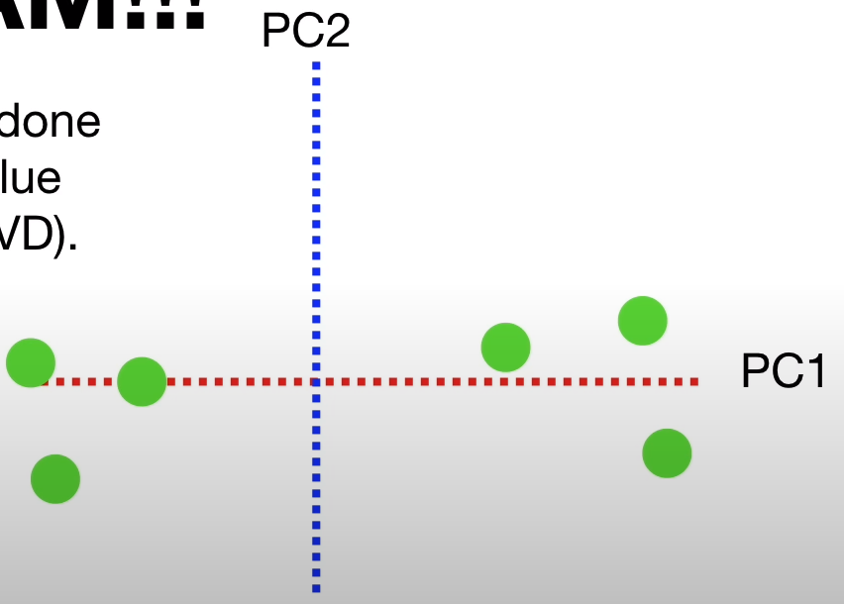
PCA Step by Step
4.) Get the final coordinates along the PCs.
We can now map the projected points bach to the samples.
Unsupervised Learning – Dimensionality Reduction
Session 6

Slide 26
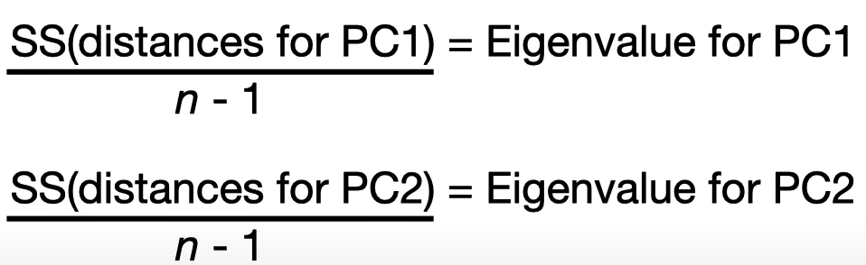
PCA – Explained Variance
Let's say the Eigenvalue for PC1 is 15 and for PC2 is 3.
The explained variance of PC1 = 15 / (15 + 3) = 0.83 = 83%
For PC2 = 3 / (15 + 3) = 0.17 = 17%
Unsupervised Learning – Dimensionality Reduction
Session 6

Slide 27
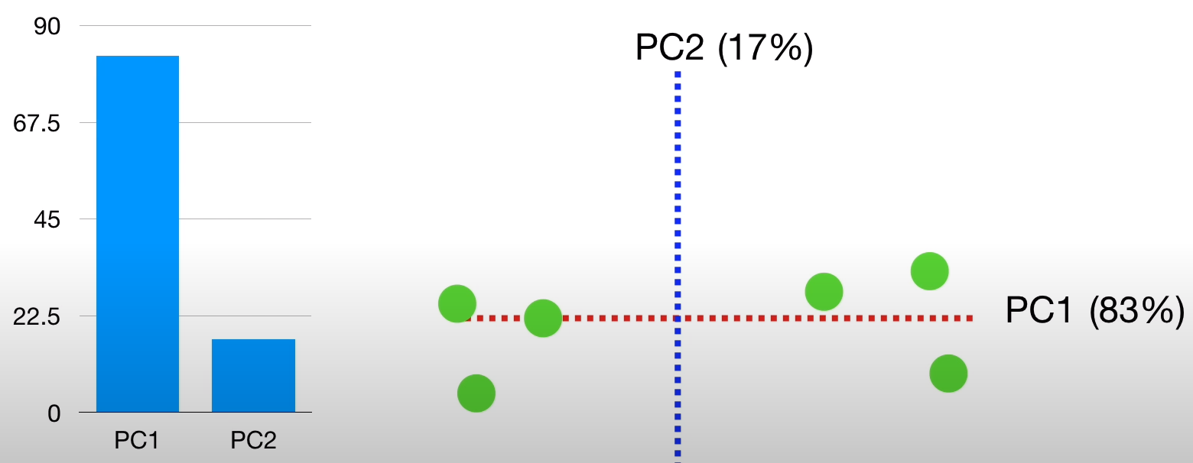
PCA – Explained Variance – Scree Plot
Unsupervised Learning – Dimensionality Reduction
Session 6

Slide 28
PCA with more Features
PCA with 3 or more features is pretty much the same as 2 features...
Feature 2
 | Feature 1 | Feature 2 | Feature 3
Sample 1 | 10 | 6 | 12
Sample 2 | 11 | 4 | 9
Sample 3 | 8 | 5 | 10
Sample 4 | 3 | 3 | 2.5
Sample 5 | 1 | 2.8 | 1.3
Sample 6 | 2 | 1 | 2
Feature 3
Feature 1
Unsupervised Learning – Dimensionality Reduction
Session 6

Slide 29
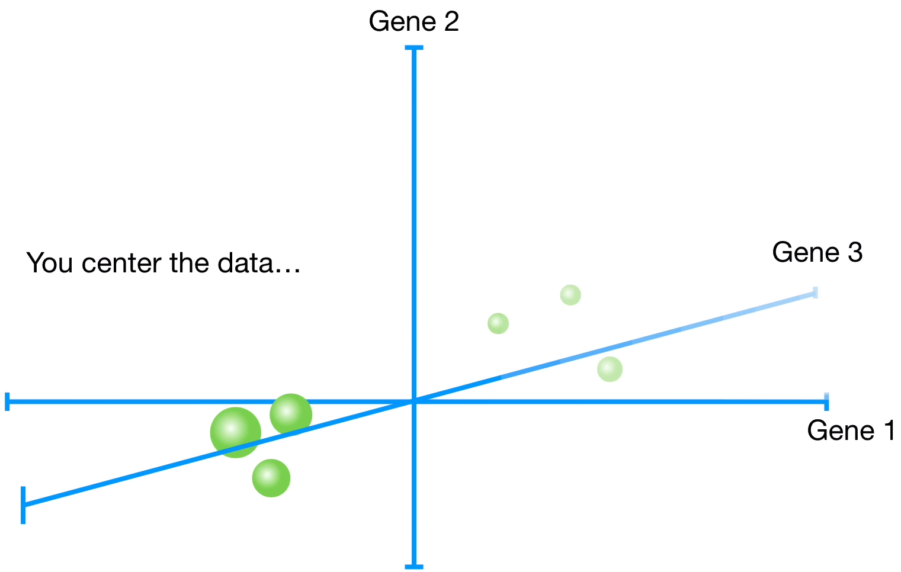
PCA with more Features
Feature 2
Feature 3
Feature 1
Unsupervised Learning – Dimensionality Reduction
Session 6

Slide 30
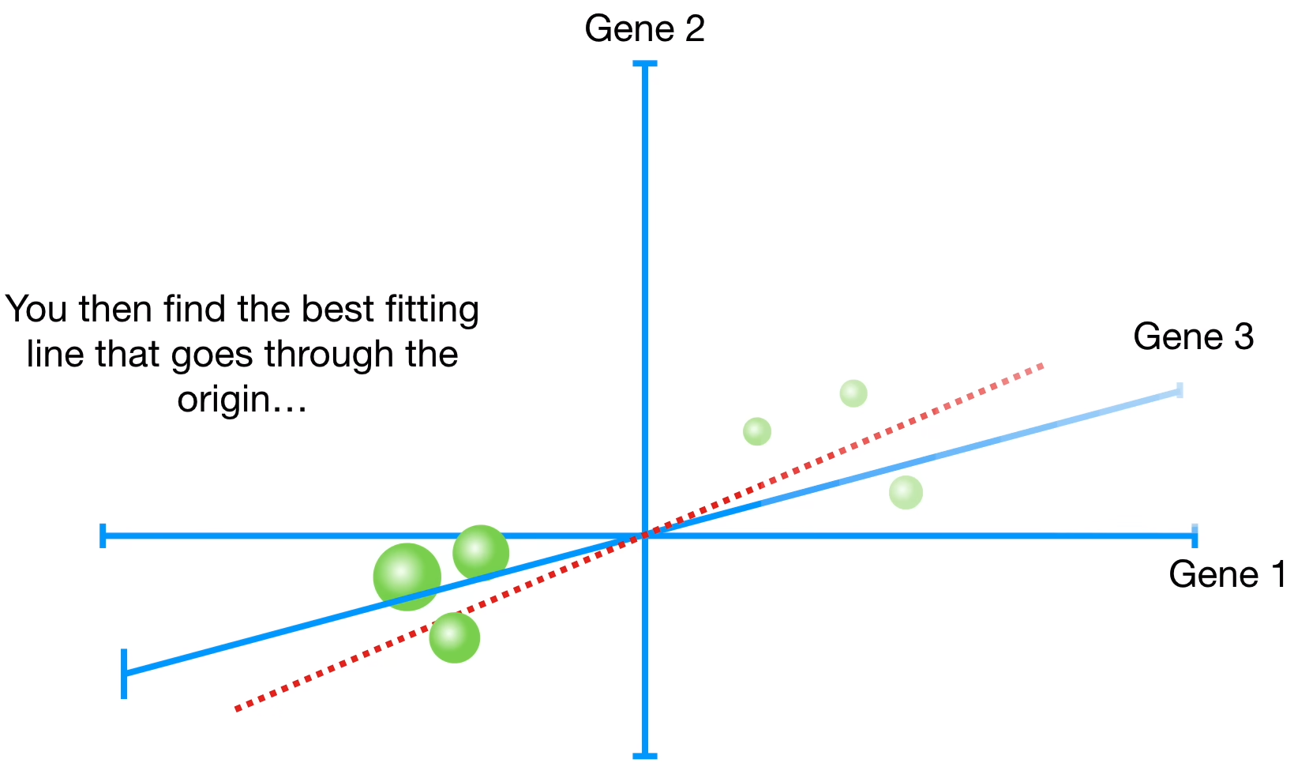
PCA with more Features
Feature 2
Feature 3
Feature 1
Unsupervised Learning – Dimensionality Reduction
Session 6

Slide 31
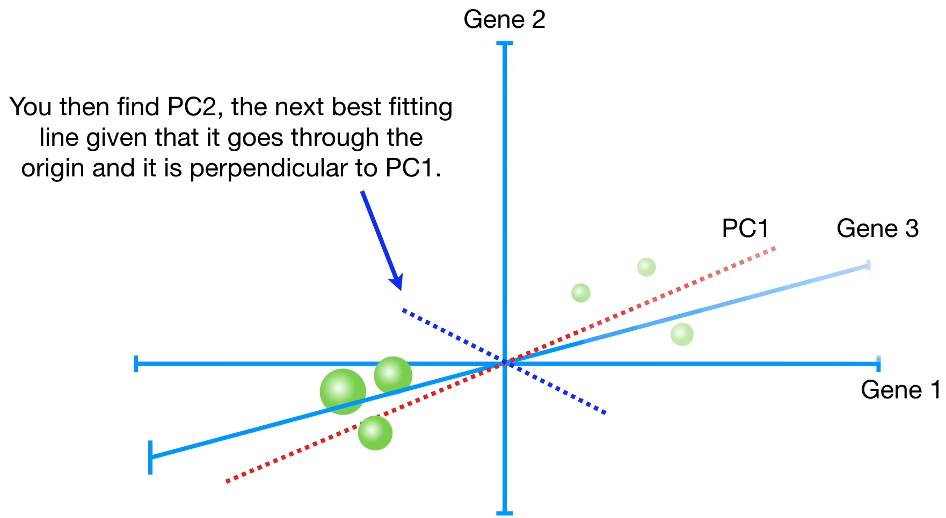
PCA with more Features
Feature 2
Feature 3
Feature 1
Unsupervised Learning – Dimensionality Reduction
Session 6

Slide 32
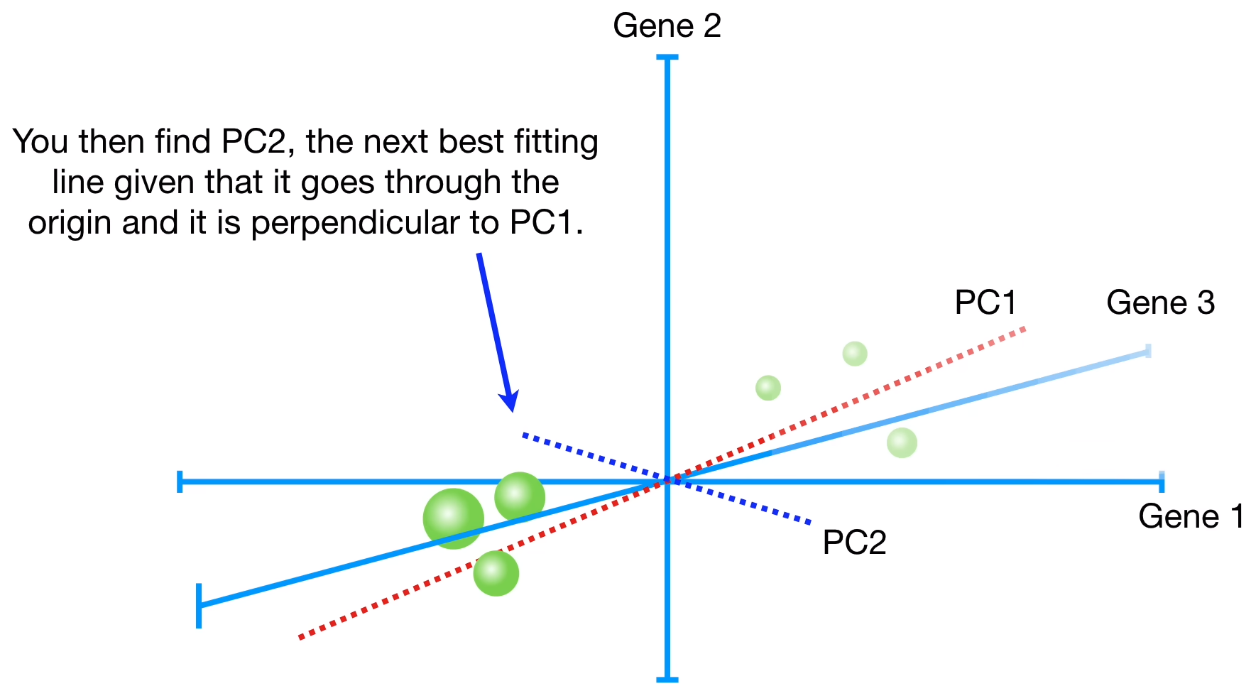
PCA with more Features
Feature 2
Feature 3
Feature 1
Unsupervised Learning – Dimensionality Reduction
Session 6

Slide 33
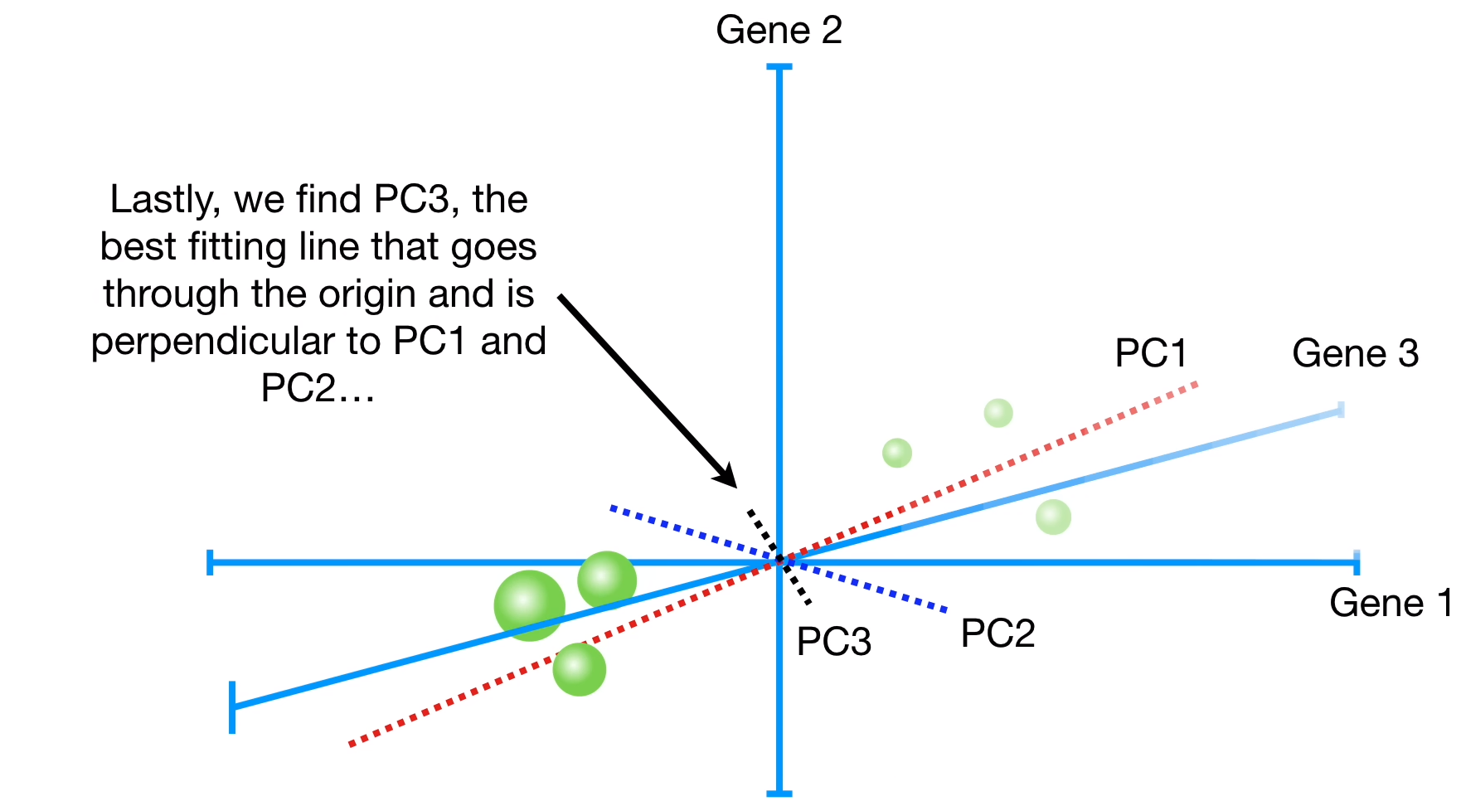
PCA with more Features
Feature 2
Feature 3
Feature 1
Unsupervised Learning – Dimensionality Reduction
Session 6

Slide 34
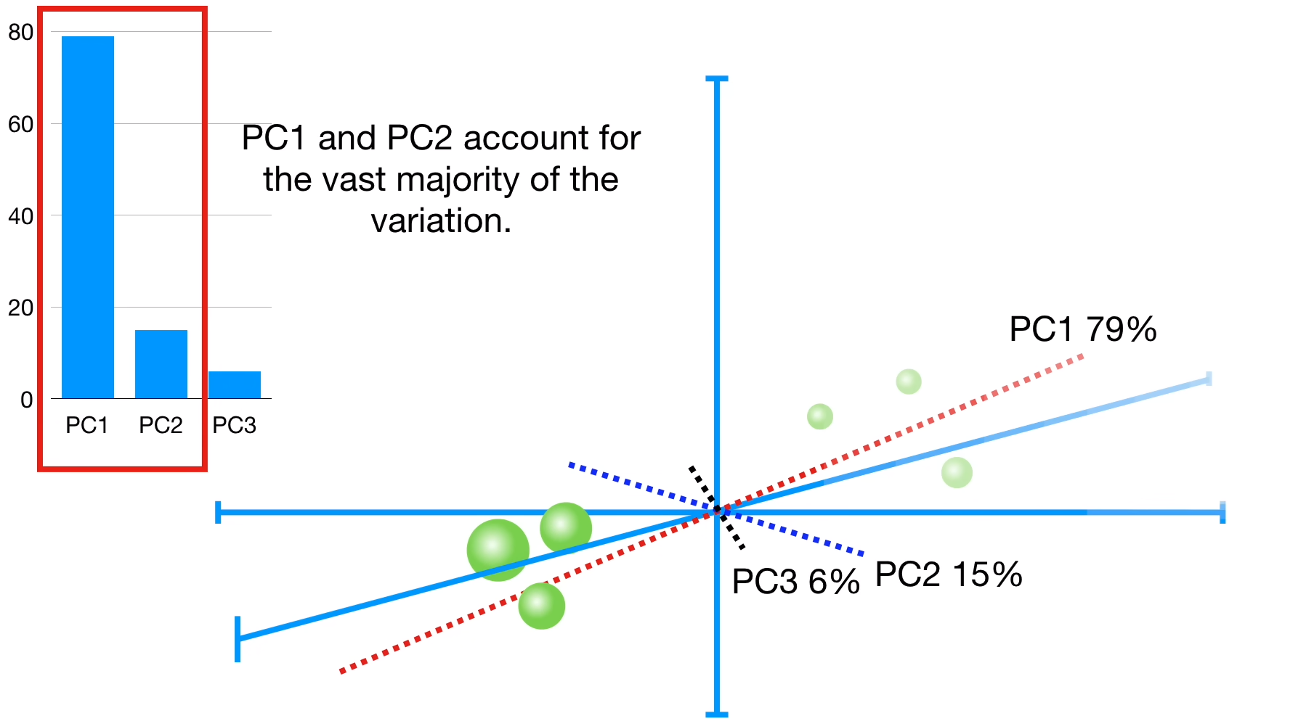
PCA with more Features
Unsupervised Learning – Dimensionality Reduction
Session 6

Slide 35
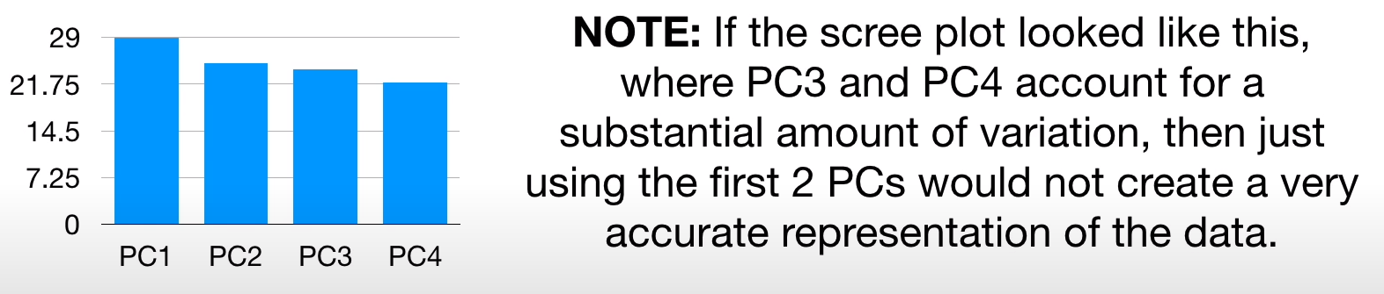
PCA with more Features
Unsupervised Learning – Dimensionality Reduction
Session 6

Slide 36
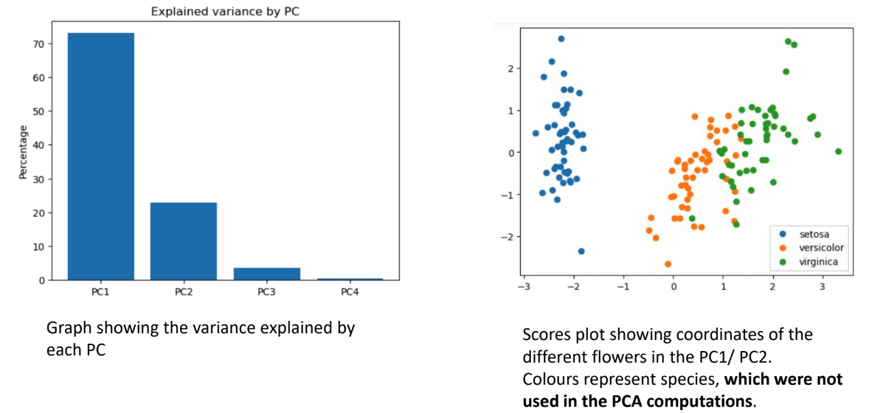
PCA example with the iris dataset
Unsupervised Learning – Dimensionality Reduction
Session 6

Slide 37
PCA Terminology
Principal Component: Linear combinations of original variables that capture the maximum variance in the data.
Eigenvector: Direction in the feature space that defines the principal components.
Eigenvalue: Scalar indicating the amount of variance explained by its corresponding eigenvector.
Explained Variance: Proportion of total variance in the data explained by each principal component.
Loading Score: Weight or coefficient assigned to each original variable in the construction of principal components.
Unsupervised Learning – Dimensionality Reduction
Session 6

Slide 38
PCA Final Considerations
Non-Linear Relationships: PCA assumes linear relationships between variables, limiting its effectiveness in capturing complex non-linear patterns; for such cases, consider non-linear techniques like t-SNE or UMAP.
Interpretability: PCA creates new combinations of features that may be hard to interpret, making it less suitable when maintaining interpretability of individual features is crucial.
Sparse Data: PCA's performance can suffer with sparse data where most values are zero or missing, leading to distortions in the data's structure.
Outliers: PCA is sensitive to outliers, which can skew results; for datasets with outliers, robust PCA techniques may be necessary to mitigate their impact.
Data Scale: PCA is sensitive to the scale of the features, so it's important to standardize or normalize the data before applying PCA to ensure that all features contribute equally to the analysis.
Unsupervised Learning – Dimensionality Reduction
Session 6

Slide 39
Other Dimesionality Reduction Techniques
Multi-Dimensional Scaling (MDS)
Objective: Reduce high-dimensional data to a lower-dimensional space while preserving pairwise relationships, enabling visualization and analysis.
Approaches:
Metric MDS: Seeks to preserve actual distances between data points in the lower-dimensional space, often utilizing optimization algorithms such as gradient descent.
Non-Metric MDS: Focuses on preserving the rank order of distances rather than their absolute values, making it suitable for ordinal or non-quantitative data.
Computationally intensive for large datasets and sensituve to input.
Unsupervised Learning – Dimensionality Reduction
Session 6

Slide 40
Other Dimesionality Reduction Techniques
t-Distributed Stochastic Neighbor Embedding (t-SNE)
Objective: Reduce high-dimensional data to a lower-dimensional space, emphasizing local relationships between data points.
Approach:
t-SNE uses a non-linear mapping approach that aims to preserve local similarities in the high-dimensional space by modeling them as conditional probabilities.
It minimizes the divergence between conditional probabilities in the high-dimensional and lower-dimensional spaces using gradient descent optimization.
Key Features:
Emphasizes preservation of local structures, making it effective for visualizing clusters and manifold structures in the data.
Particularly useful for exploring complex and non-linear relationships in high-dimensional datasets.
Unsupervised Learning – Dimensionality Reduction
Session 6

Slide 41
Other Dimesionality Reduction Techniques
Uniform Manifold Approximation and Projection (UMAP)
Objective: Reduce the dimensionality of high-dimensional data while preserving both local and global structure, offering a balance between preserving local details and capturing global patterns.
Approach:
UMAP constructs a high-dimensional graph representing local relationships between data points and optimizes the embedding in a lower-dimensional space to match the graph topology.
It employs a combination of fuzzy set theory and Riemannian geometry to model the manifold structure of the data.
Key Features:
Preserves both local and global structure, allowing for a more comprehensive representation of the data.
Offers flexibility in balancing preservation of local details and capturing global patterns through parameter tuning.
Known for its scalability and efficiency, making it suitable for large datasets.
Unsupervised Learning – Dimensionality Reduction
Session 6

Slide 42
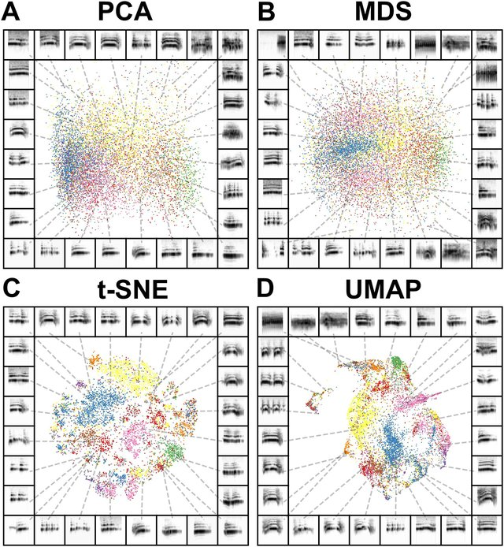
PCA vs MDS vs tSNE vs UMAP
Sainburg, T., Thielk, M., & Gentner, T. Q. (2020). Finding, visualizing, and quantifying latent structure across diverse animal vocal repertoires. In F. E. Theunissen (Ed.), PLOS Computational Biology (Vol. 16, Issue 10, p. e1008228). Public Library of Science (PLoS). https://doi.org/10.1371/journal.pcbi.1008228
Unsupervised Learning – Dimensionality Reduction
Session 6

Slide 43
Resources
Dimension Reduction: A Guided Tour:
(https://www.microsoft.com/en-us/research/wp-content/uploads/2016/02/FnT_dimensionReduction.pdf)
Oskolkov, N. (2022). Dimensionality Reduction. In Applied Data Science in Tourism (pp. 151–167). Springer International Publishing. https://doi.org/10.1007/978-3-030-88389-8_9
Unsupervised Learning – Dimensionality Reduction
Session 6

